Slide 1
1-paper

Slide 2
Relaxed optimistic optimization 16
The research focuses on solving the optimistic LQR problem
The approach uses extended value iteration (EVI)
The method provides explicit computational complexity and eO(√T) regret guarantees
Current systems are susceptible to exploitation, presenting a significant constraint
The study addresses the challenges of applying existing methods to Large Language Models (LLMs)

Slide 3
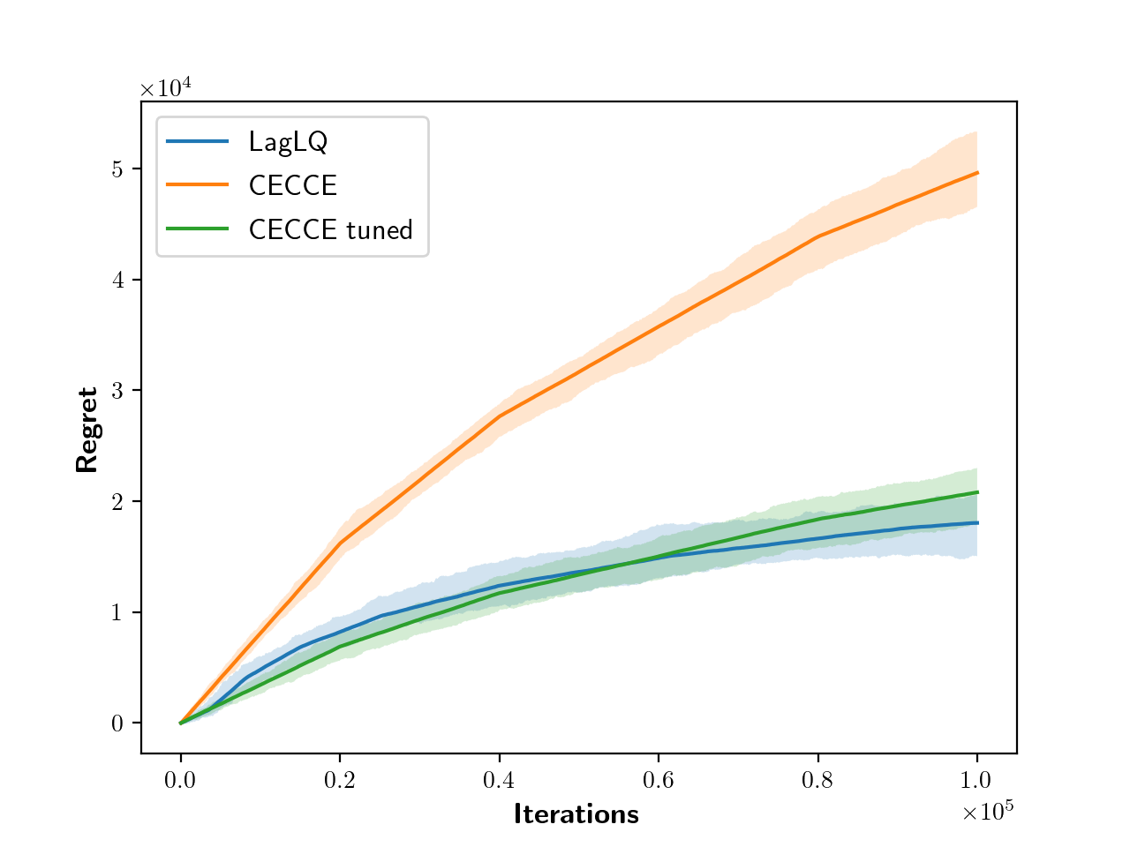
Relaxed optimistic optimization 16 - Image 1

Slide 4
Solve optimistic lqr explicit
The research focuses on solving optimistic LQR problems
The approach utilizes extended value iteration (EVI)
The algorithm aims to return an ϵ-optimistic and ϵ-feasible policy
The algorithm is designed to avoid over-exploration by considering cost sensitivity
The optimization in (16) maintains the learning guarantees of the original OFU-LQ algorithm

Slide 5
Propose relax optimistic optimization
The document discusses solving the optimistic LQR problem with explicit computational complexity and eO(√T) regret guarantees
The approach is inspired by extended value iteration (EVI)
The document addresses the susceptibility of current systems to exploitation and potential hallucination issues
Computational requirements for training LLMs, which involve millions or billions of parameters, are discussed
The optimization process preserves the learning guarantees of the original OFU-LQ algorithm

Slide 6
Lqr lagrangian relaxation introduce
The document introduces a Lagrangian formulation to solve constrained Linear-Quadratic Regulator (LQR) problems
The approach provides an efficient optimistic exploration method, named LAGLQ, for LQR problems with explicit computational complexity and eO(√T) regret guarantees
The method uses Lagrangian relaxation and solves at most O(log(1/ϵ)) Riccati equations to compute an ϵ-optimistic controller
The approach addresses the limitations of existing optimistic LQR methods, improving efficiency and removing certain constraints
The paper demonstrates strong duality and shows that the algorithm can provide a solution to the original problem at any accuracy level

Slide 7
Relax optimistic optimization ofu
The document discusses optimistic LQR (Linear Quadratic Regulator) problems and their computational complexity
The approach is inspired by extended value iteration (EVI)
The research addresses the susceptibility of current systems to exploitation
Training large language models (LLMs) requires substantial computational resources
LLMs are limited in their ability to benefit from methods designed to improve other systems due to complexity

Slide 8
Efﬁcient optimistic exploration linear
Over-exploration can occur when there's an asymmetry in cost sensitivity related to estimation error
Optimistic LQR problems are addressed by methods like OFU-LQ++ and LAGLQ
Large language models (LLMs) are experiencing rapid advancements due to deep learning, PLMs, extensive datasets, and hardware improvements
A key challenge for current systems is their susceptibility to exploitation, affecting both language models (LMs) and knowledge graphs (KGs)
The precision of LLMs in discerning true statements is improving

Slide 9
Lagrangian relaxation regret
The document focuses on an efficient optimistic exploration method for Linear-Quadratic Regulators (LQR) using Lagrangian relaxation
The method achieves an ϵ-optimistic and ϵ-feasible solution for constrained LQR
The approach, named LAGLQ, is inspired by extended value iteration (EVI)
LAGLQ provides eO(√T) regret guarantees, potentially outperforming the worst-case √T bound in some scenarios
The solution involves a Lagrangian formulation and solving Riccati equations

Slide 10
Quadratic regulators lagrangian relaxation
The document focuses on efficient optimistic exploration within the Linear-Quadratic Regulator (LQR) framework
The core approach involves using Lagrangian relaxation to solve a constrained LQR problem
The method offers an efficient and optimal confidence-based algorithm for LQR, with computational advantages
The algorithm, named LAGLQ (Lagrangian-LQ), achieves regret guarantees related to the length of the initial phase and ϵ-optimality
The approach leverages optimistic extended controllers and addresses challenges related to non-convexity in the optimization problem

Slide 11
Solve similar optimistic optimization
The text discusses solving the optimistic LQR problem with computational complexity and regret guarantees
The approach is inspired by extended value iteration (EVI)
The text touches on the susceptibility of current systems to exploitation and the importance of fine-tuning for specific tasks
Optimization preserves learning guarantees of the original OFU-LQ algorithm
Large Language Models (LLMs) don't benefit from methods due to their complexity and inaccessibility of architecture and parameter space

Slide 12
Optimistic controllers generated solving
The text addresses the optimistic LQR problem, offering explicit computational complexity and regret guarantees
The approach is inspired by extended value iteration (EVI)
A significant constraint of current systems is their susceptibility to exploitation
LLMs may struggle with these methods due to architectural complexity
The text also touches upon code completion and program synthesis, suggesting their utility in software development

Slide 13
Formulation solution optimistic controller
Large Language Models (LLMs) are complex, making it difficult to apply traditional methods for performance improvement
LLMs are susceptible to exploitation and can produce incorrect or fabricated information (hallucination)
Training LLMs requires significant computational resources due to the large number of parameters and the need for extensive datasets
Optimistic controllers are introduced for Linear Quadratic Regulator (LQR) problems, but their practical application faces computational challenges
The text touches upon the need to address bias and ethical concerns in LLM development

Slide 14
Relax optimistic optimization
The research focuses on solving optimistic LQR problems with explicit computational complexity and regret guarantees
The approach is inspired by extended value iteration (EVI) and utilizes optimistic extended controllers
Current systems are susceptible to exploitation
Training LLMs, involving millions or billions of parameters, presents significant computational requirements
The optimization process preserves learning guarantees

Slide 15
Duality result optimistic controller
Current language models (LLMs) are susceptible to exploitation and prone to "hallucination
"
The precision of LLMs in discerning true statements is improving
LLMs do not currently benefit from methods due to architectural complexity and inaccessibility
Training LLMs requires significant computational resources due to the large number of parameters

Slide 16
Lqr efﬁcient optimistic exploration
The text focuses on solving the optimistic LQR problem with explicit computational complexity and regret guarantees
The approach is inspired by extended value iteration (EVI) and aims to provide tight regret guarantees
The text discusses the performance of confidence-based exploration strategies, including OFU-LQ++ and LAGLQ
A key challenge addressed is the potential for over-exploration and its impact on regret bounds
The research also touches on the use of Large Language Models (LLMs) for specialized tasks, mentioning applications and limitations like hallucination

Slide 17
Optimistic optimization 16 lagrangian
The paper introduces an efficient, optimistic, confidence-based algorithm (LAGLQ) for Linear-Quadratic Regulators (LQR)
LAGLQ is based on Lagrangian relaxation of the extended LQR problem
The algorithm provides eO(√T) regret guarantees
An ϵ-optimistic controller can be efficiently computed by solving at most O(log(1/ϵ)) algebraic Riccati equations
LAGLQ leverages Dual Search-OFU (DS-OFU) within the OFU-LQ++ learning scheme

Slide 18
Relaxed optimistic optimization
The text focuses on solving the optimistic LQR (Linear Quadratic Regulator) problem
The approach uses an extended value iteration (EVI) method
The method provides explicit computational complexity and eO(√T) regret guarantees
The research relates to addressing the susceptibility of current systems to exploitation, specifically within the context of language models (LLMs)
LLMs' complexities and inaccessibility of their architecture and parameter space make it hard to apply certain methods

Slide 19
Regulators lagrangian relaxation regret
Here's a summary of the text in concise bullet points:
The paper introduces a Lagrangian relaxation approach for efficient optimistic exploration in Linear-Quadratic Regulators (LQR)
The proposed algorithm, LAGLQ, achieves sublinear regret, potentially outperforming worst-case bounds by adapting to problem structure
The method involves solving a constrained LQR problem, for which strong duality is proven
An epsilon-optimistic and epsilon-feasible solution is computed efficiently by solving a Riccati-based algorithm

Slide 20
Optimistic optimization ofu lq
The research focuses on optimizing the OFU-LQ algorithm to maintain learning guarantees while addressing computational complexity
The extended value iteration (EVI) approach is utilized to solve optimistic LQR problems
The algorithm addresses over-exploration issues related to cost sensitivity estimation errors
The work discusses the use of relaxed versions of the original OFU-LQ++ problem to obtain optimistic solutions
A significant constraint of current systems is their susceptibility to "hallucination"

Slide 21
Duality relaxed optimistic optimization
Current systems are susceptible to exploitation, requiring further examination
The precision of Language Models (LLMs) in discerning true statements can potentially be improved
LLMs don't currently benefit from certain optimization methods due to their complex architectures
Training LLMs involves processing millions or billions of parameters, leading to significant computational requirements
Optimistic extended controllers can induce fiable claims

Slide 22
Optimistic exploration linear quadratic
The research focuses on solving the optimistic LQR problem
The approach is inspired by the extended value iteration (EVI) algorithm
The method aims to address the exploration-exploitation dilemma in the linear quadratic regulator (LQR) setting
The algorithm leverages asymmetry from the confidence set to avoid over-exploration in certain directions
The research discusses limitations, such as susceptibility to exploitation and the potential for "hallucination" in current systems

